Slide 1

Docker
Lecture-2
www.corvit.com

Slide 2
Topics
Ways to Create Docker Images
Creating Images from Container and making New Containers
Dockerfile
Dockerfile Components
Docker Image Layers
Configuring Apache Server
Configuring Node.js App
Configuring Mongo DB
Container logging
Running Multiple Services in a Container
Container Linking
www.corvit.com

Slide 3
Ways to Create Docker Images
There are 3 ways to create Docker Images :
Pull Image form Docker Hub and run it
From Dockerfile
From the Container
www.corvit.com

Slide 4
Creating Images from Container and making New Containers
docker run –it --name mycontainer ubuntu /bin/bash
cd tmp/
touch myfile
docker diff mycontainer (In output C means Change, A means Append or Add, D means deleted)
docker commit mycontainer updateimage
docker run –it --name farancontainer updateimage /bin/bash
cd tmp/
ls
www.corvit.com

Slide 5
Dockerfile
A Docker File is a simple text file with instructions on how to build your images.
Dockerfile is abasically a test file.
It contains some set of instructions
Automation of Docker image creation.
Create a file called Dockerfile. Please note that the name of the file has to be "Dockerfile" with "D" as capital.
You Configure the Dockerfile with using Dockerfile components
Build image from the Dockerfile and run containers using that image.
www.corvit.com

Slide 6
Dockerfile Components
FROM: For base image. This command must be on top of the Dockerfile
RUN: To execute Commands. It will create a layer in image.
MAINTAINER: Author/ Owner/ Description.
COPY: Copy files from local system. We need to provide Source, Destination. We can’t download file from internet and any remote repo.
ADD: Similar to Copy but it provides a feature to download file from internet, also we extract file at docker image side.
EXPOSE: to expose ports such as port 8080 for tomcat, port 80 for nginx etc.
WORKDIR: to set working directory for a Container
CMD: Execute Commands but during Container Creation
ENTRYPOINT: Similar to CMD but has higher priority over CMD. First commands will be executed by ENTRYPOINT only
ENV: Environment Variables.
ARG: ARG are also known as build-time variables. They are only available from the moment they are ‘announced’ in the Dockerfile with an ARG instruction up to the moment when the image is built. Running containers can’t access values of ARG variables.
Note: Use Capital Letters for all these Components while configuring in Dockerfile.
Example: Ubuntu Base Image Through Dockerfile
www.corvit.com

Slide 7
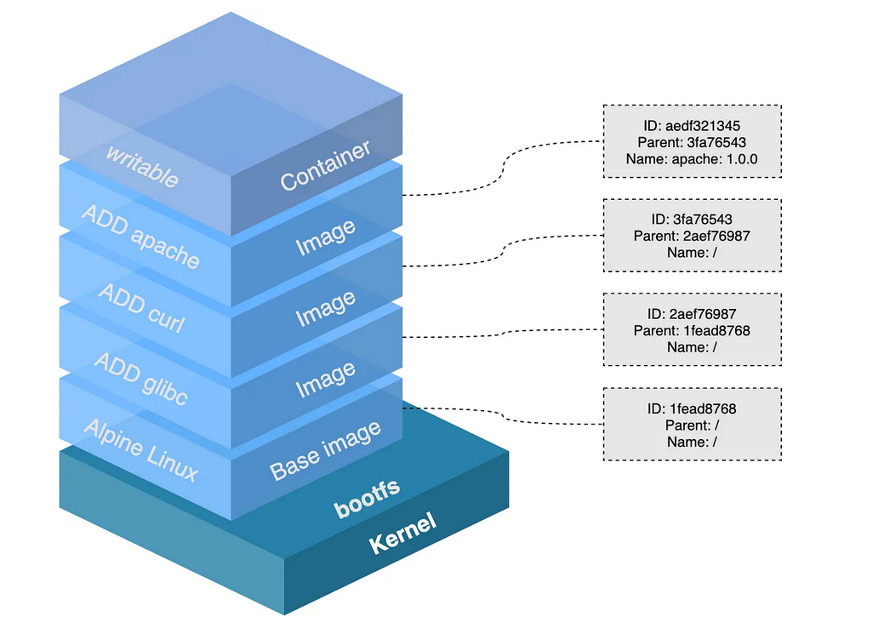
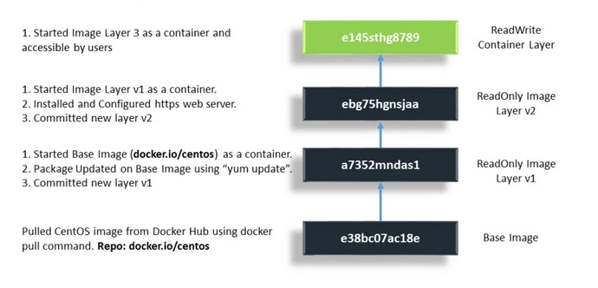
Docker Image Layers
www.corvit.com
Notes:
https://www.howtogeek.com/devops/what-are-docker-image-layers/
https://pikanpie.wordpress.com/2019/03/16/docker-image/
https://ragin.medium.com/docker-what-it-is-how-images-are-structured-docker-vs-vm-and-some-tips-part-1-d9686303590f

Slide 8
Configuring Apache Web Server with Dockerfile
www.corvit.com

Slide 9
Configuring Node.js App with Dockerfile
www.corvit.com

Slide 10
Mongo DB
www.corvit.com
Notes:
https://www.tutorialspoint.com/docker/docker_setting_mongodb.htm
https://jojozhuang.github.io/programming/creating-mongodb-image-with-dockerfile/

Slide 11
Container logging
At the daemon logging level, there are four levels of logging available:
Debug − It details all the possible information handled by the daemon process.
Info − It details all the errors + Information handled by the daemon process.
Errors − It details all the errors handled by the daemon process.
Fatal − It only details all the fatal errors handled by the daemon process.
www.corvit.com

Slide 12
Debugging
First, we need to stop the docker daemon process, if it is already running. It can be done using the following command
sudo service docker stop
Now we need to start the docker daemon process. But this time, we need to append the –l parameter to specify the logging option. So let’s issue the following command when starting the docker daemon process
sudo dockerd –l debug &
The following points need to be noted about the above command −
dockerd is the executable for the docker daemon process.
The –l option is used to specify the logging level. In our case, we are putting this as debug
& is used to come back to the command prompt after the logging has been enabled.
Once you start the Docker process with logging, you will also now see the Debug Logs being sent to the console.
Now, if you execute any Docker command such as docker images, the Debug information will also be sent to the console.
docker images
www.corvit.com

Slide 13
Container Logging
Logging is also available at the container level. So in our example, let’s spin up an Ubuntu container first. We can do it by using the following command.
docker run –it ubuntu /bin/bash
Run few commands
Now, we can use the docker log command to see the logs of the container.
docker logs <Container ID>
www.corvit.com

Slide 14
Running Multiple Services in a Container
A container’s main running process is the ENTRYPOINT and/or CMD at the end of the Dockerfile.
It is generally recommended that you separate areas of concern by using one service per container. That service may fork into multiple processes (for example, Apache web server starts multiple worker processes).
It’s ok to have multiple processes, but to get the most benefit out of Docker, avoid one container being responsible for multiple aspects of your overall application.
You can connect multiple containers using user-defined networks and shared volumes.
The container’s main process is responsible for managing all processes that it starts. In some cases, the main process isn’t well-designed, and doesn’t handle “reaping” (stopping) child processes gracefully when the container exits.
If your process falls into this category, you can use the --init option when you run the container.
The --init flag inserts a tiny init-process into the container as the main process, and handles reaping of all processes when the container exits.
Handling such processes this way is superior to using a full-fledged init process such as sysvinit, upstart, or systemd to handle process lifecycle within your container.
www.corvit.com

Slide 15
Container Linking
Container Linking allows multiple containers to link with each other. It is a better option than exposing ports or running services in a single container
In this lab we would link Jenkins container with a Ubuntu image container
www.corvit.com
Notes:
https://www.tutorialspoint.com/docker/docker_setting_mongodb.htm

